Slide 1
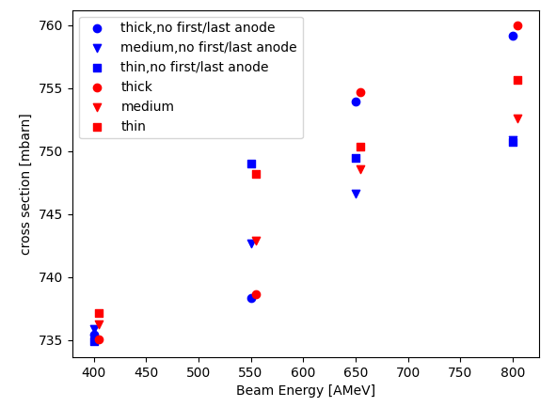
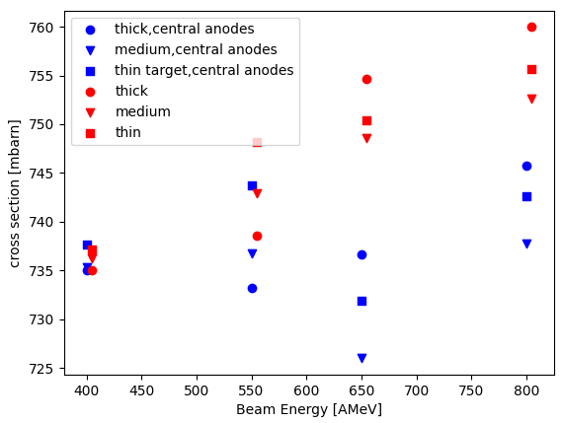
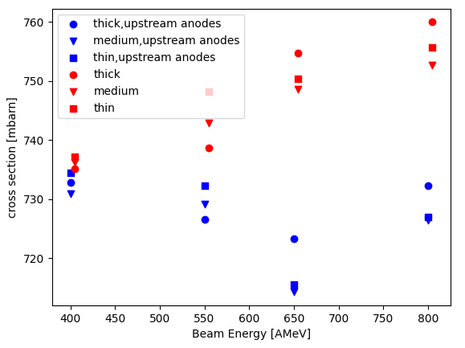
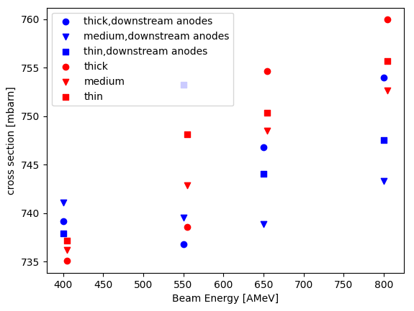
a) 2D gauss fit with borders using anodes 2-8 and 9-15
c) 2D gauss fit with borders using anodes 5-8 and 9-12
b) 2D gauss fit with borders using anodes 1-4 and 5-8
d) 2D gauss fit with borders using anodes 9-12 and 13-16

